Slide 1
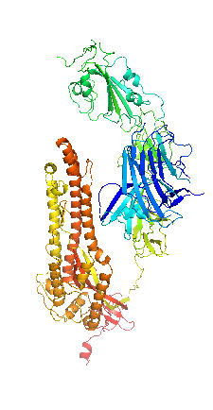
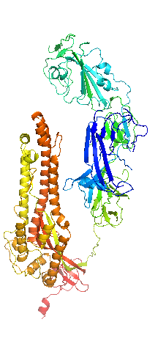
Closed 6VXX
Open 6VYB
COV2
main differences

Slide 2
